Slide 1
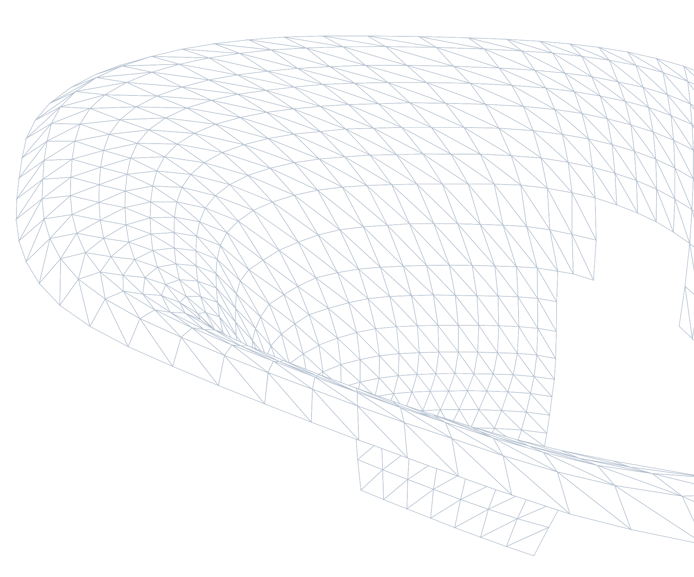
DFF - Robotic Lab Expansion
Environmental Study - Solar gains + Daylight
20/10/2026
Notes:
Title Slide – External Presentation
Update text for your presentation

Slide 2
Environmental design study
Schematic workflow to study effect of shading and glazing on radiation and daylight
(Study 1)
Façade geometry
Incident solar radiation on facade
Filter using allowable peak solar gain
+
Peak incident solar radiation
x
Glazing shading coefficient (SC)
Peak solar heat gain
Overhang depth
(study parameter)
(study parameter)
(MEP engineer input)
Selected configs studied further for daylight compliance
Aim: show how the depth of the roof canopy and the solar-control performance of the glass (shading coefficient, SC) reduce the solar heat gain through the façade; compare the result with the solar load the MEP's HVAC design allows for; and take the compatible options forward to a daylight check (sDA / ASE).
(Study 2)

Slide 3
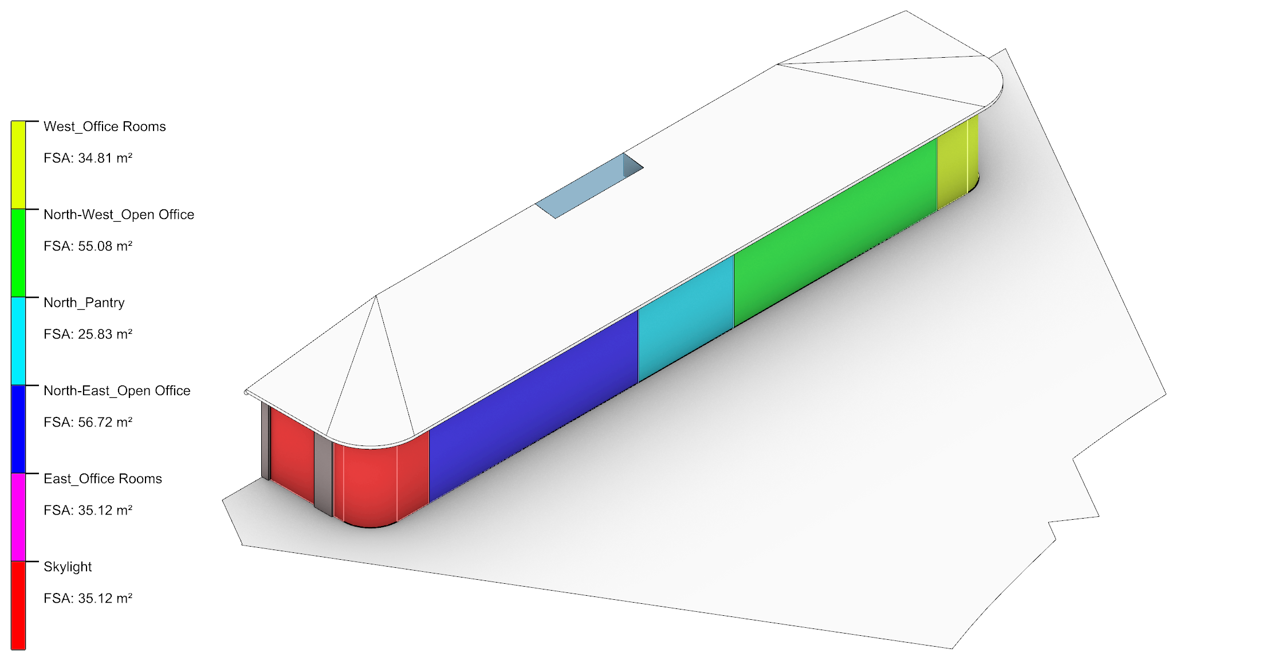
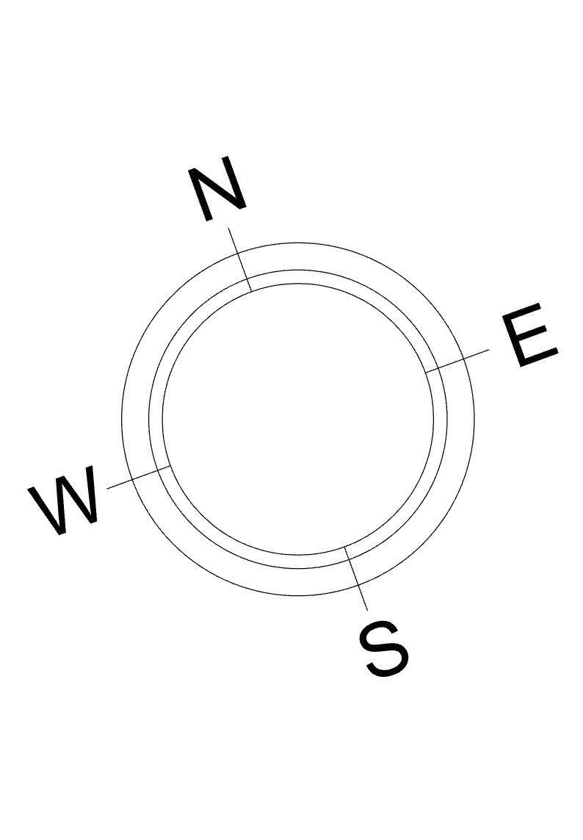
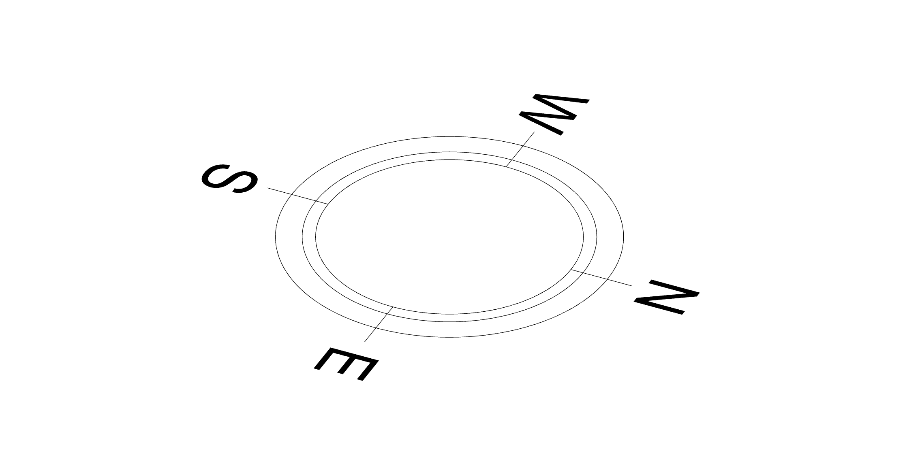
Façade Zones
Façade zones based on floor plan
Five façade zones shown in plan
Façade divide into five zones
Note: Set-up: the glazed façade is split into five zones that follow the floor plan, so every result can be traced back to a space.

Slide 4
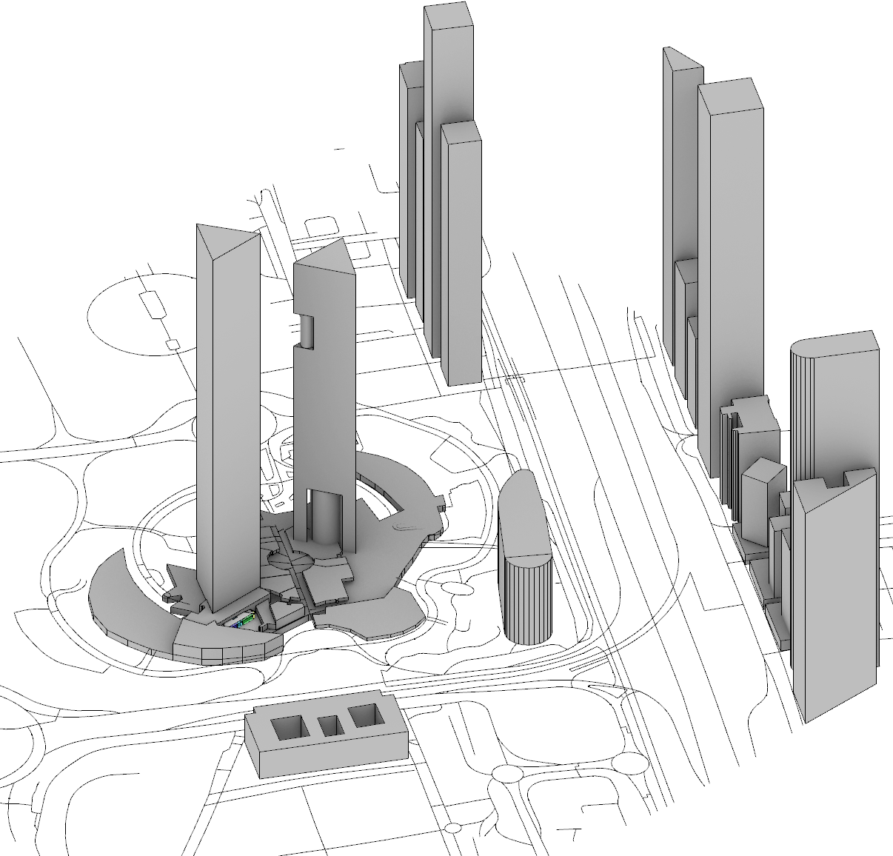
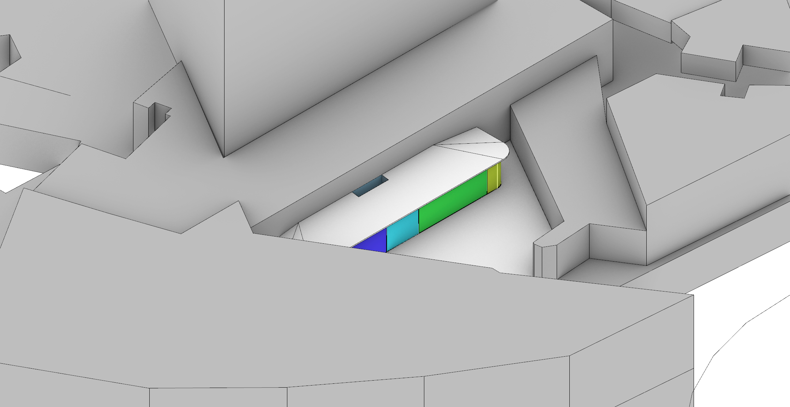
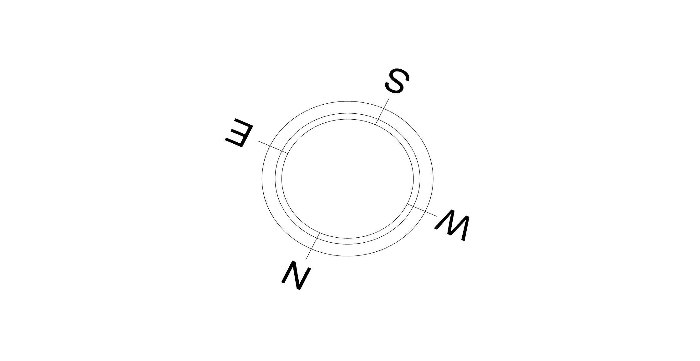
Analysis Geometry
Lab located along with its context
1 · Set-up: the pavilion is modelled with its surroundings; the neighbouring buildings shade much of the low east and west sun.
Façade model with context
Zoom-in of faced from North-west aerial view

Slide 5
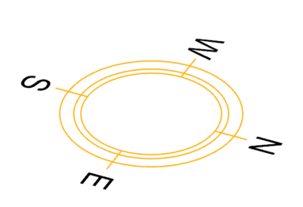
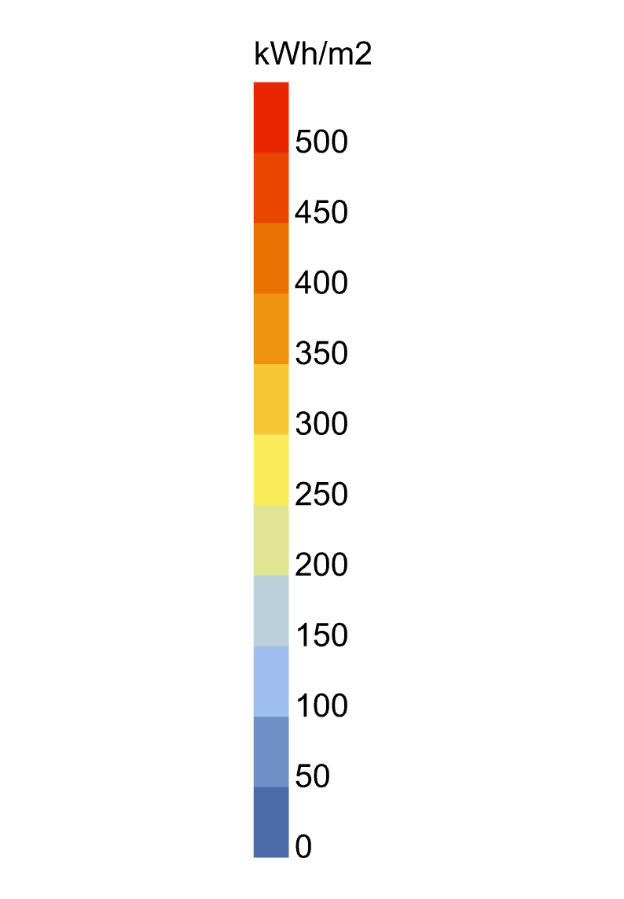
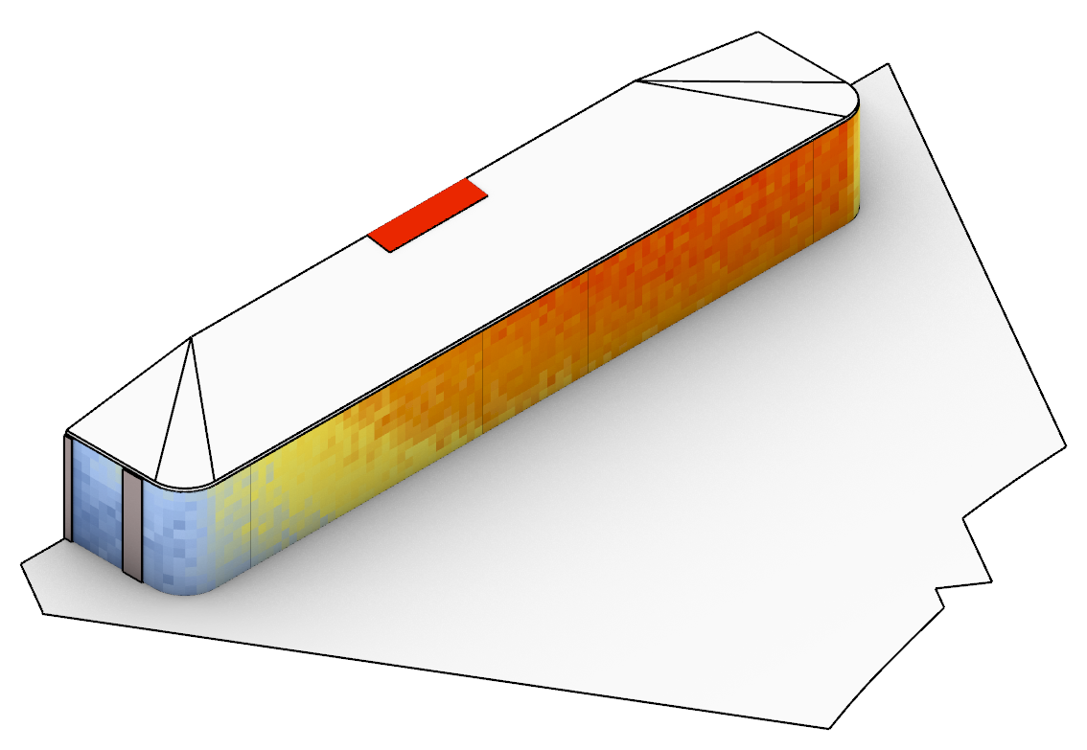
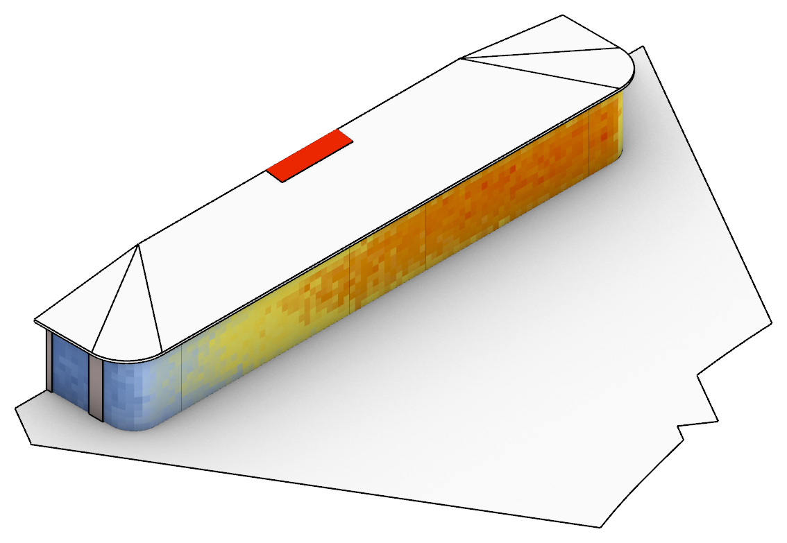
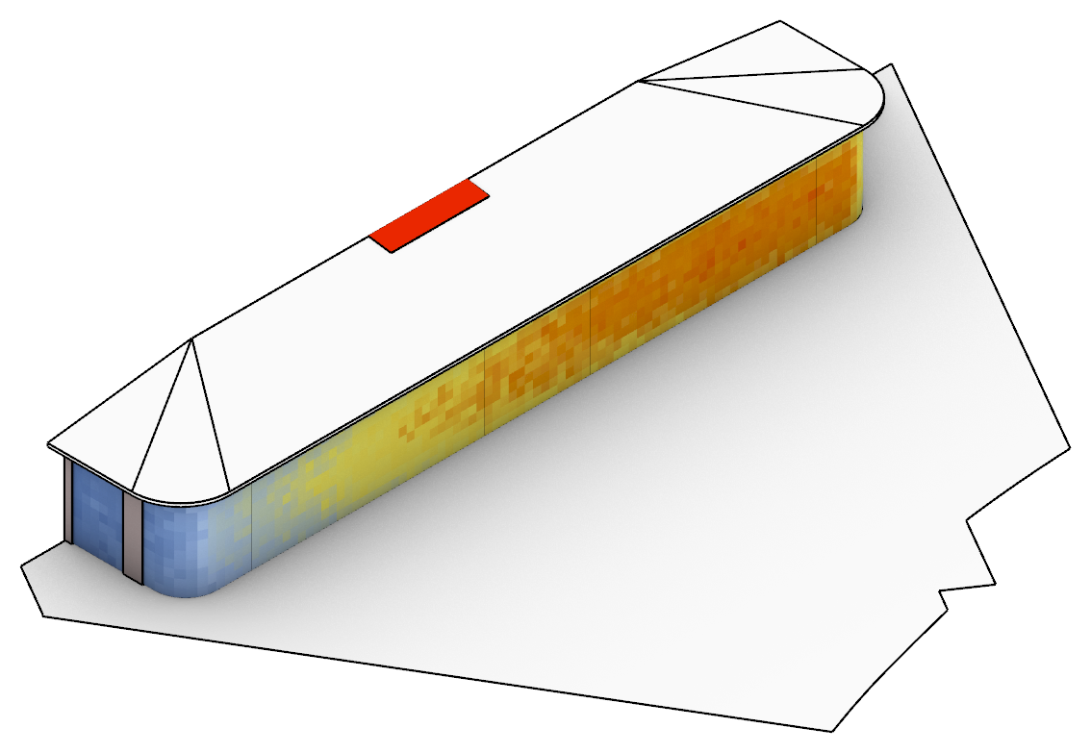
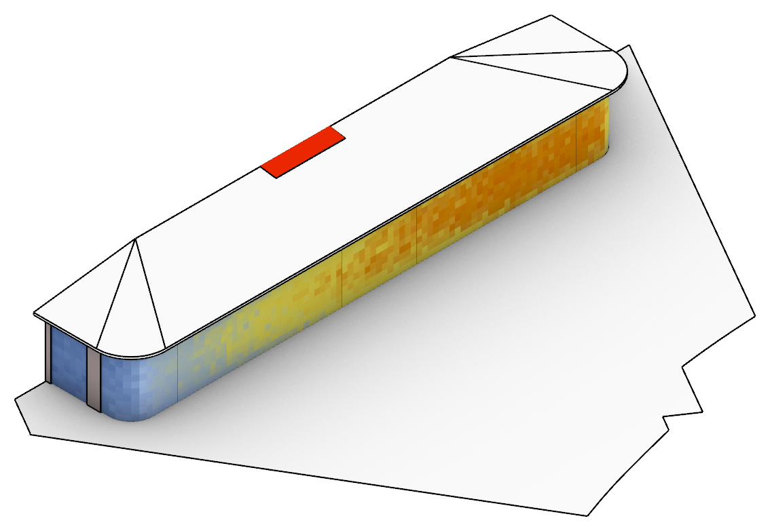
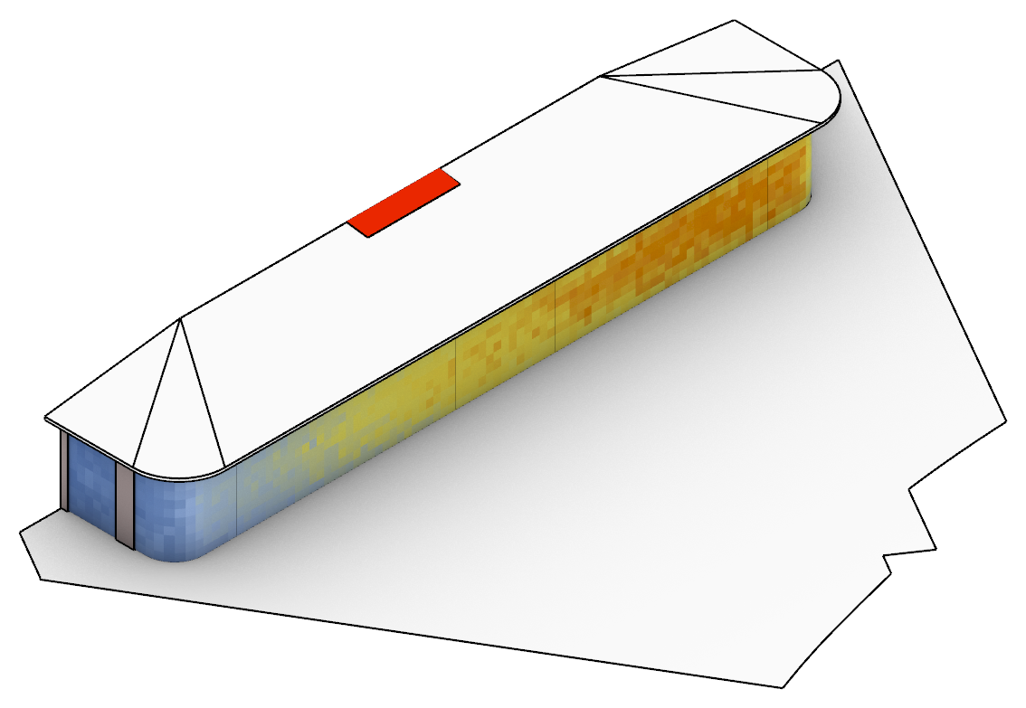
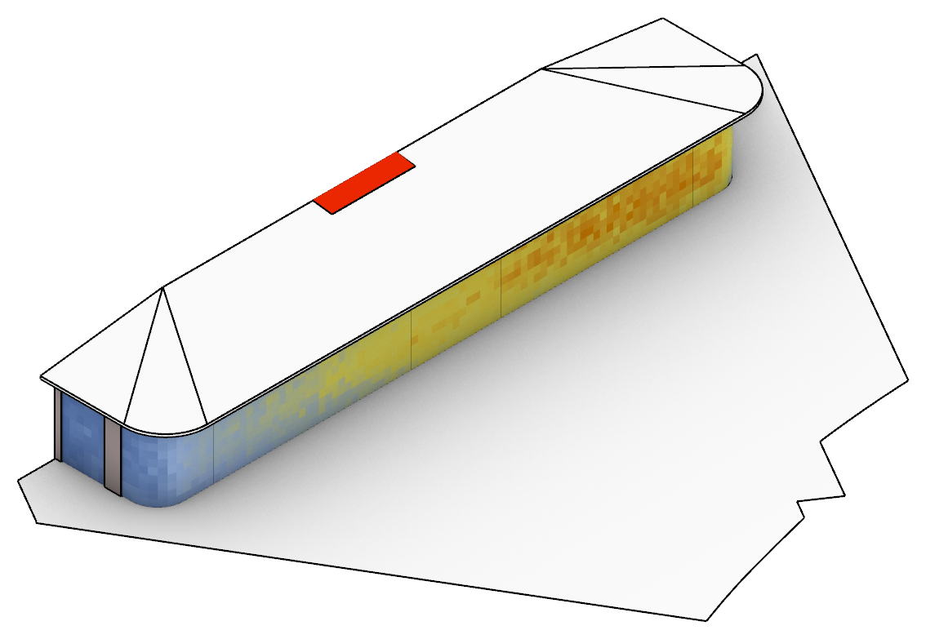
Incident Solar Radiation
Effect of canopy depth on incident façade radiation (typical year)
2 · How much sun reaches the glass: deepening the canopy from 0 to 1.5 m cuts annual façade radiation by a third (290.9 to 192.2 kWh/m²·yr) and the façade peak from 53.1 to 33.2 kW.
Architect's option 1
Architect's option 2
Overhang depth
0mm
Annual incident solar irradiation (façade mean)
290.9 kWh/m²·yr
Peak incident solar irradiance *
256 W/m²
Peak incident power (façade)
53.1 kW
@ 12-Jun 09:00
Overhang depth
500mm
Annual incident solar irradiation (façade mean)
247.1 kWh/m²·yr
Peak incident solar irradiance *
212 W/m²
Peak incident power (façade)
44.0 kW
@ 28-May 08:00
Overhang depth
750mm
Annual incident solar irradiation (façade mean)
231.5 kWh/m²·yr
Peak incident solar irradiance *
203 W/m²
Peak incident power (façade)
42.2 kW
@ 24-Jun 08:00
Overhang depth
1000mm
Annual incident solar irradiation (façade mean)
216.8 kWh/m²·yr
Peak incident solar irradiance *
190 W/m²
Peak incident power (façade)
39.5 kW
@ 12-Jun 08:00
Overhang depth
1250mm
Annual incident solar irradiation (façade mean)
202.8 kWh/m²·yr
Peak incident solar irradiance *
176 W/m²
Peak incident power (façade)
36.5 kW
@ 11-Jun 08:00
Overhang depth
1500mm
Annual incident solar irradiation (façade mean)
192.2 kWh/m²·yr
Peak incident solar irradiance *
160 W/m²
Peak incident power (façade)
33.2 kW
@ 11-Jun 08:00
* Peak incident solar irradiance on the façade glazing (area-weighted mean at the façade's peak hour) [W/m²]. Typical year (TMYx), side canopies 1.0 m on all options. The skylight (~745 kWh/m²·yr) is above the legend range.

Slide 6
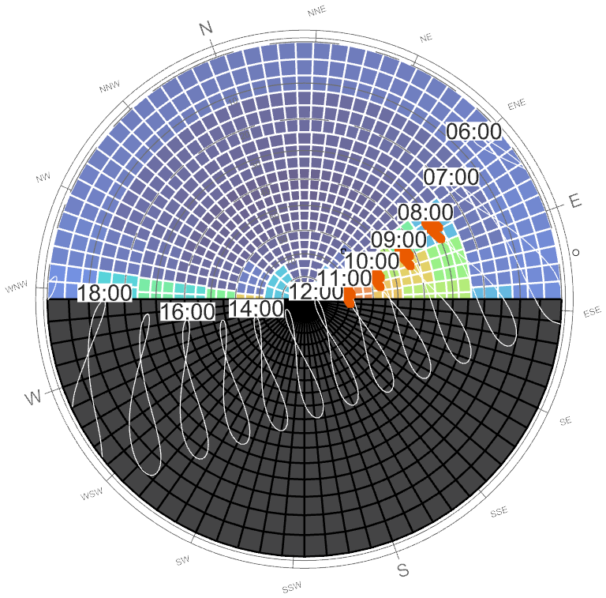
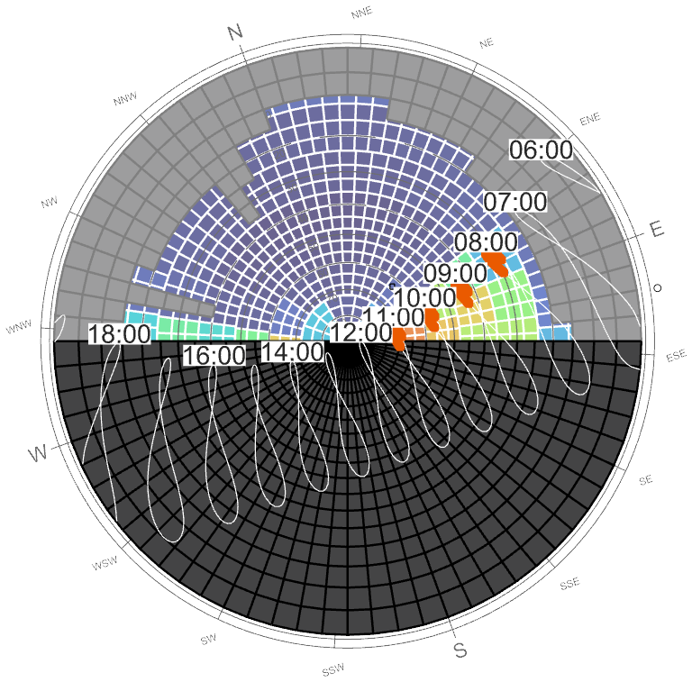
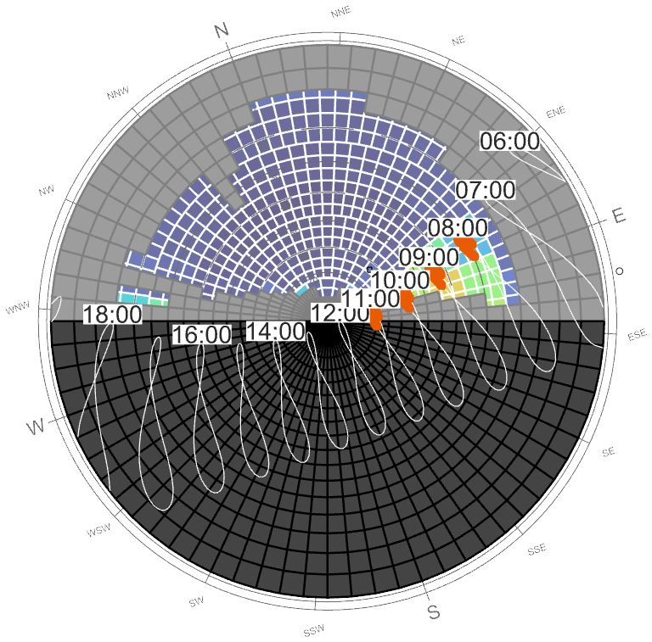
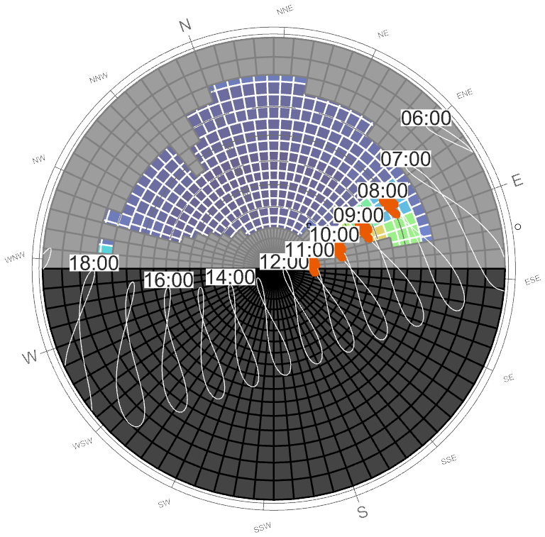
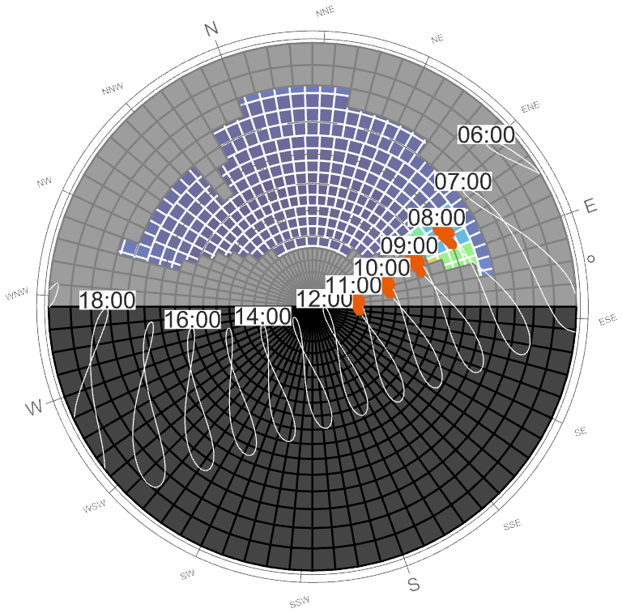
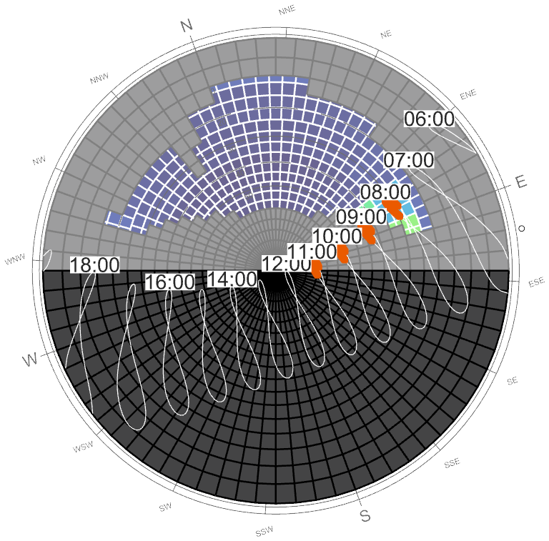


Sky Access & Shading Masks
Sun path, sky radiation and shading masks (North-West Open Office)
3 · When the peak arrives: only on May–July mornings (08:00–11:00), with the sun low in the east-north-east – a horizontal canopy can only partly block it.
Reference: 0 mm, no surroundings (all daylight hours)
0 mm + surroundings
500 mm + surroundings
750 mm + surroundings
Colours: solar radiation from each patch of sky, occupied hours (08–18, Mon–Fri) [kWh/m²]
Black: sky behind the façade
Grey: sky blocked by the canopy and surrounding buildings
White figure-8s: sun position at each clock hour through the year (labels on 21 June)
Orange: peak window, May–Jul 08:00–11:00 (hours with ≥ 80 % of the annual peak solar load)
1000 mm + surroundings (Architect's option 1)
1250 mm + surroundings
1500 mm + surroundings (Architect's option 2)
Deepening the canopy grows the grey mask down from the top of the sky. The sun that drives the peak (orange) sits low in the east-north-east: from the centre of the pane the deeper canopies hide the 10:00–11:00 sun, but the 08:00–09:00 sun still reaches the glass even at 1.5 m depth.
Take-away: the radiation peak on the façade happens on May–July mornings, so it is the morning sun that is driving the peak solar power on the facade.

Slide 7
Peak solar heat gain through glazing
Canopy depth x glass shading coefficient (SC) at the annual peak
4 · From radiation to heat gain: solar heat gain = incident solar × 0.87 × SC, shown for three glass options at the façade's annual peak.
Glass option | SC | SHGC (= 0.87 × SC) | Typical VLT | Al Sa'fat 2023 – whole-building WWR < 40 % * | Comment
Façade A | 0.25 | 0.22 | ~45–50 % | Meets (SC ≤ 0.40, LT ≥ 0.40) | Stronger solar control; least daylight
Façade B | 0.32 | 0.28 | ~65–70 % | Meets (SC ≤ 0.40, LT ≥ 0.40) | Best available at ~70 % VLT (top-end coating)
Façade C | 0.40 | 0.35 | ~70–72 % | Meets – at the SC limit | Code limit (whole-building reading); MEP's HAP assumption
Skylight | 0.25 | 0.22 | ~40 % | Meets (roof glazing ≤ 10 %) | All options; fritting optional
* Assumes the lab is assessed with the existing tower (combined WWR < 40 %: SC ≤ 0.40, LT ≥ 0.40, summer U ≤ 2.1 W/m²K) – to be confirmed. VLT values are typical estimates.
Overhang depth | Peak solar heat gain, window + skylight (typical year TMYx) |  |  | Combined heat-gain peak hour | Peak incident solar on façade
 | SC 0.25 | SC 0.32 | SC 0.40
[mm] | [kW] | [kW] | [kW] | [hour start] | [kW]
0 mm | 12.56 | 15.79 | 19.49 | 12-Jun 09:00 | 53.1
500 mm | 10.49 | 13.14 | 16.17 | 12-Jun 09:00 | 44.0
750 mm | 9.96 | 12.53 | 15.47 | 24-Jun 08:00 | 42.2
1000 mm | 9.40 | 11.80 | 14.55 | 12-Jun 08:00 | 39.5
1250 mm | 8.76 | 10.99 | 13.53 | 11-Jun 08:00 | 36.5
1500 mm | 8.02 | 10.04 | 12.35 | 11-Jun 08:00 | 33.2
Solar heat gain = 0.87 × SC × incident solar (façade) + 0.87 × 0.25 × incident solar (skylight), at the hour of the annual maximum (typical year, TMYx 1973–2025).
The three columns showing peak (kW) are the highest hourly solar heat gain through façade + skylight over the whole typical year, for each façade glass (the skylight is SC 0.25 throughout). Peak hour is when that worst hour occurs which is always a June morning, 08:00–10:00. The last column is the sun reaching the façade before the glazing filters it. It's the raw input that the canopy controls.

Slide 8
Window + Skylight Solar Heat Gain
Canopy depth x glass SC vs the previous HAP solar-load reference
5 · Check against the MEP engineer’s HAP model dated 21/08/2026 : with SC 0.40 (~70 % VLT) every depth exceeds its 4.7 kW solar component; SC 0.25 glass with ≥ 750 mm stays at or below it.
Canopy depth | Façade incident solar, MEP July hour | Heat gain at MEP July hour (21 Jul, ~14:00) |  |  | Heat gain at MEP June hour (21 Jun, ~13:00), SC 0.40 | Annual maximum heat gain, SC 0.40 | Annual maximum: hour start | Highest façade SC that stays ≤ 4.7 kW at the July hour
 |  | SC 0.25 | SC 0.32 | SC 0.40
[mm] | [kW] | [kW] | [kW] | [kW] | [kW] | [kW] | [date hh:mm] | [-]
0 mm | 25.12 | 5.72 | 7.25 | 9.00 | 11.52 | 19.62 | 20-Jun 09:00 | 0.20
500 mm | 21.29 | 4.90 | 6.20 | 7.68 | 10.17 | 16.43 | 20-Jun 09:00 | 0.24
750 mm | 19.96 | 4.61 | 5.83 | 7.22 | 9.74 | 14.47 | 20-Jun 09:00 | 0.25
1000 mm | 18.83 | 4.36 | 5.51 | 6.82 | 9.08 | 13.51 | 16-Jun 08:00 | 0.27
1250 mm | 17.97 | 4.15 | 5.25 | 6.50 | 8.65 | 12.37 | 16-Jun 08:00 | 0.29
1500 mm | 16.89 | 3.95 | 4.98 | 6.15 | 8.12 | 11.31 | 18-Jun 08:00 | 0.30
Clear-sky design day (ASHRAE tau model, Dubai Intl. AP) on 21 Jul / 21 Jun, taking the higher of the two hours either side of the previous HAP times (sun at 13:30/14:30 and 12:30/13:30). Using the highest of all July days instead of the 21st raises July values by ~15–20 % (1500 mm, SC 0.40: 6.15 → 7.28 kW). Solar heat gain = 0.87 × (SC × façade incident + 0.25 × skylight incident).
≤ 4.7 kW – at or below the MEP engineer’s HAP solar-load reference (not an agreed limit)
Key points
With SC 0.40 (~70 % VLT) the July heat gain is 6.15–9.00 kW: above the MEP engineer’s HAP reference (4.75 kW) at every depth; 1500 mm comes closest.
SC 0.25 glass stays at or below the reference from 750 mm (4.61 kW) to 1500 mm (3.95 kW); SC 0.32 does not (4.98 kW at 1500 mm).
The annual maximum falls on June mornings (11.3–19.6 kW at SC 0.40), above the July value considered by the MEP.
Per m² of glass the July heat gain at SC 0.40 is 29–42 W/m², against 74 W/m² in the previous HAP model; the glazed area is 3.3× larger (213.7 vs 64 m²). MEP engineer to confirm the glazing areas.
The last column is the highest façade SC that keeps the window + skylight heat gain at or below 4.7 kW at the July design hour (21 July, ~14:00).

Slide 9
Clear-Sky Design Day vs Typical Year
Heat gain at SC 0.40: MEP July hour vs annual maximum
6 · Timing: this façade's heat gain peaks on June mornings, 5.2–6.5 kW above its July-afternoon value at 1500 mm.
Canopy depth | Heat gain at MEP July hour (~14:00) |  | Annual maximum heat gain
 | Design day (21 Jul) | Typical year (highest July day) | Design day | Hour start | Typical year | Hour start
[mm] | [kW] | [kW] | [kW] | [date hh:mm] | [kW] | [date hh:mm]
0 mm | 9.00 | 8.60 | 19.62 | 20-Jun 09:00 | 19.49 | 12-Jun 09:00
500 mm | 7.68 | 6.94 | 16.43 | 20-Jun 09:00 | 16.17 | 12-Jun 09:00
750 mm | 7.22 | 6.71 | 14.47 | 20-Jun 09:00 | 15.47 | 24-Jun 08:00
1000 mm | 6.82 | 6.42 | 13.51 | 16-Jun 08:00 | 14.55 | 12-Jun 08:00
1250 mm | 6.50 | 6.12 | 12.37 | 16-Jun 08:00 | 13.53 | 11-Jun 08:00
1500 mm | 6.15 | 5.82 | 11.31 | 18-Jun 08:00 | 12.35 | 11-Jun 08:00
Façade SC 0.40, skylight SC 0.25. Design day = ASHRAE clear sky (tau model, 2009 coefficients; Dubai Intl. AP), 21st of the month. Typical year = TMYx Dubai Intl. AP (source period 1973–2025), highest July day. Hour start, e.g. 08:00 = 08:00–09:00, local standard time. Solar heat gain, not a HAP cooling load; no safety factor.
≤ 4.7 kW – at or below the MEP’s HAP solar-load reference
Key points
Both skies put the annual maximum on June mornings (08:00–10:00), not at the previously considered MEP’s HAP design hour (July 14:00).
At 1500 mm the annual maximum exceeds the July value by 5.2 kW on the design day (11.31 vs 6.15) and 6.5 kW in the typical year (12.35 vs 5.82).
The two skies agree on the timing of the peak but not exactly on the peak value itself, so both are reported.
Deeper canopies lower both values, but at SC 0.40 even 1500 mm stays above 4.7 kW.

Slide 10
Assumptions
Inputs for the current six-depth solar screening (slides 5–9).
Method: Honeybee/Radiance annual incident irradiance on the glazing (0.4 m sensor grid, -ab 3; grid/bounce convergence not tested). North canopy 0 / 0.5 / 0.75 / 1.0 / 1.25 / 1.5 m; side canopies 1.0 m (0 m for the 0 mm option); skylight included.
Weather: Dubai Intl. AP TMYx (source period 1973–2025) and an ASHRAE clear-sky design day (tau model, Ladybug default 2009 coefficients with the STAT optical depths; the 2017 coefficients give ~1–4 % higher loads). Design-day values use the 21st of the month.
Solar heat gain = 0.87 × SC × incident solar (constant SHGC): instantaneous gain, not a HAP cooling load; no overall conservatism is claimed.
Reference: previous HAP solar-load components 4.752 kW (zone peak, Jul 14:00) and 4.644 kW (air-system design-report condition, Jun 13:00), before the 10 % safety factor – not an agreed limit for the new façade.
Compliance (to confirm with the permit consultant): pavilion assessed with the existing tower, combined WWR < 40 % → SC ≤ 0.40, LT ≥ 0.40, summer U ≤ 2.1 W/m²K (Al Sa'fat 2023).
Sun-path dome: occupied hours 08:00–18:00, Mon–Fri. Surface reflectance:
Surface | Reflectance
Glazing | 0.20
Opaque façade | 0.40
Roof / overhang | 0.50
Ground (light paver, weathered) | 0.35
Context | 0.30
Far-field ground (sky model) | 0.20

Slide 11
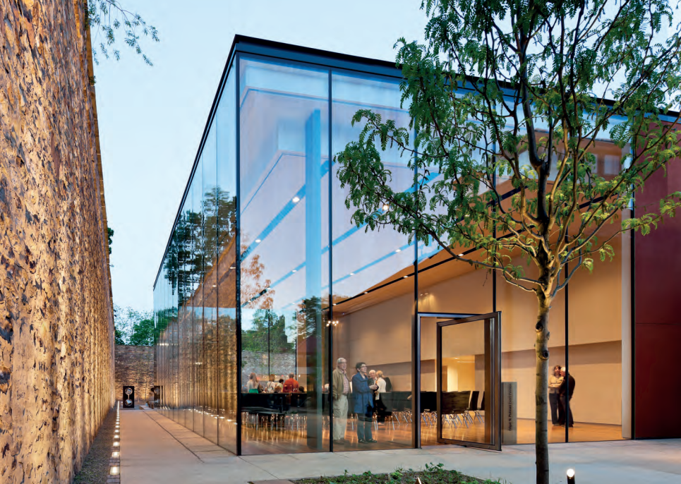
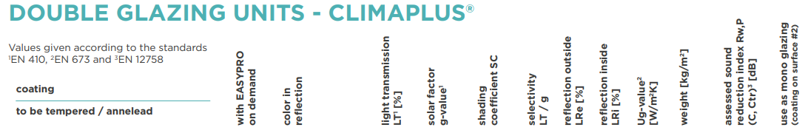
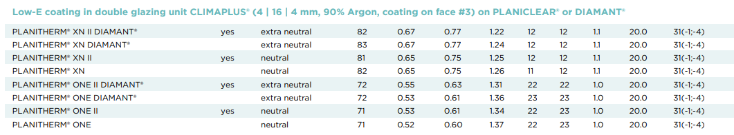
Precedents
PLANITHERM ® ONE II DIAMAN
Precedents: built examples of the glass types discussed (manufacturer EN data – to be replaced by NFRC data for the agreed build-up).
Glass manufacturer: Saint-Gobain
LT: 72%
EN g-value (reference assembly): 0.55
The James A. Michener Museum Event Pavilion, Pennsylvania

Slide 12
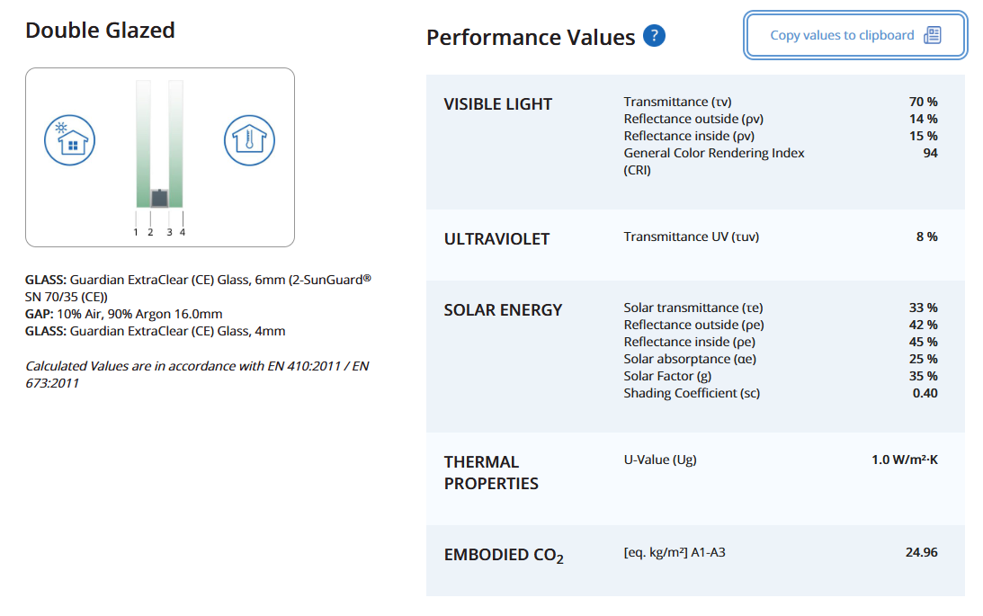
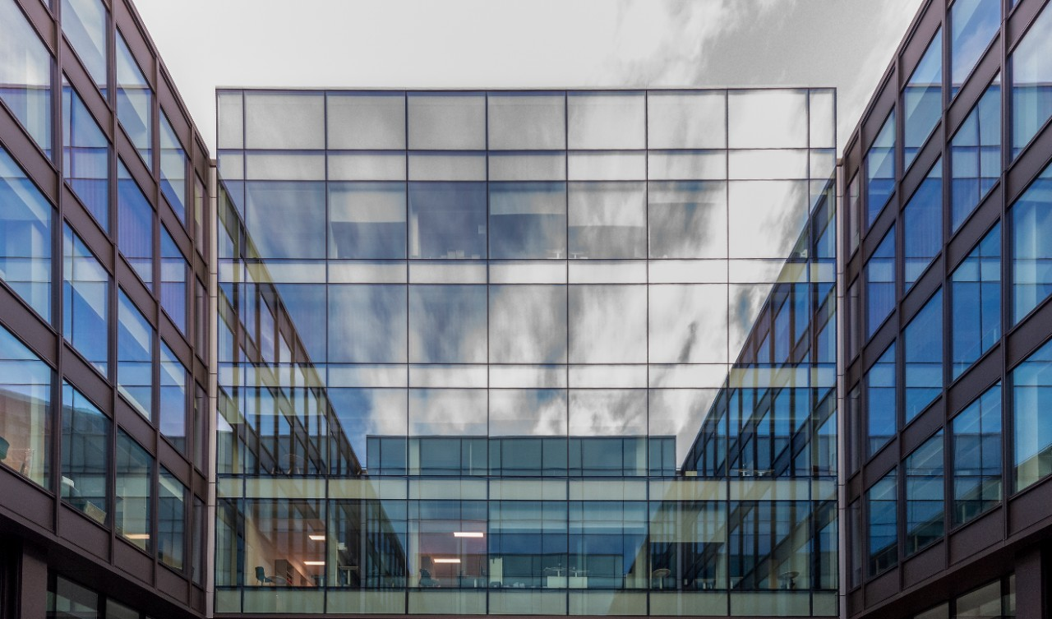
Precedents
SunGuard® SuperNeutral SN 70/35
Precedents: built examples of the glass types discussed (manufacturer EN data – to be replaced by NFRC data for the agreed build-up).
Glass manufacturer: Guardian
LT: 70%
EN g-value (reference assembly): 0.35
The Fruit and Wool Exchange (courtyard), London

Slide 13
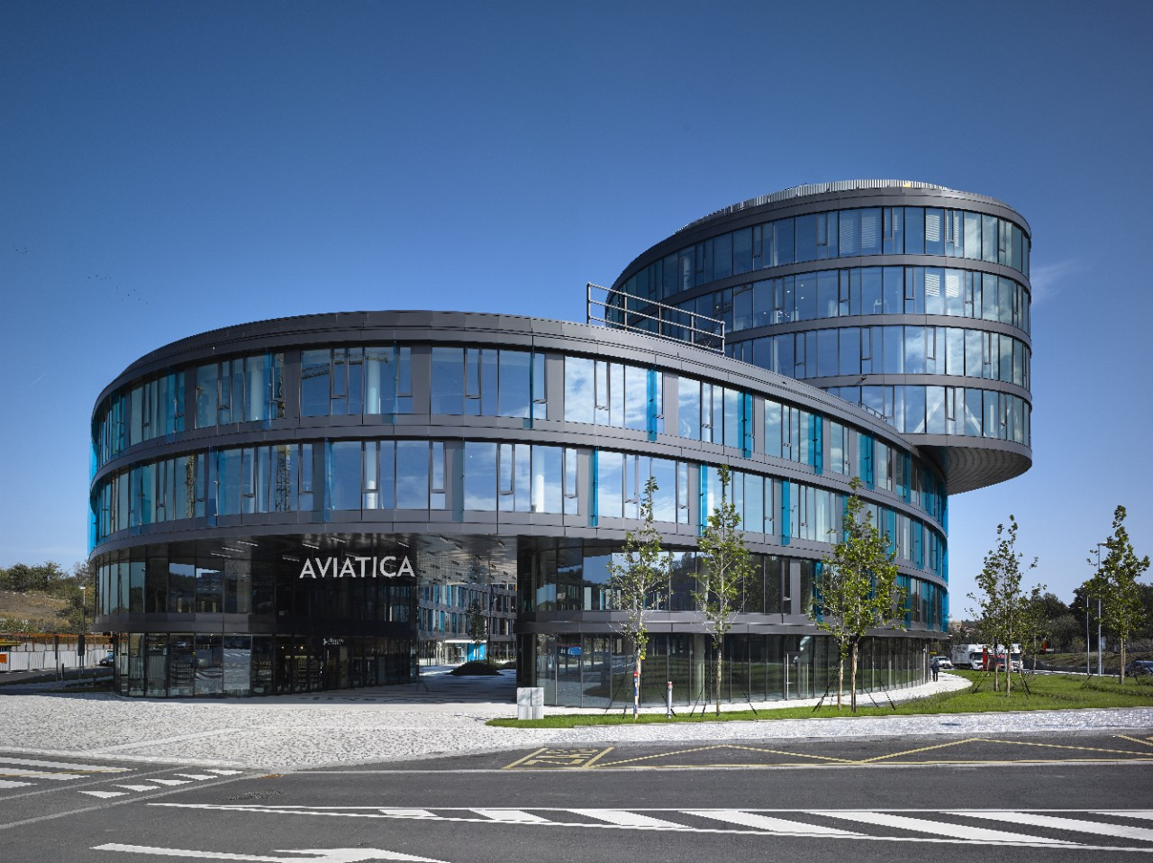
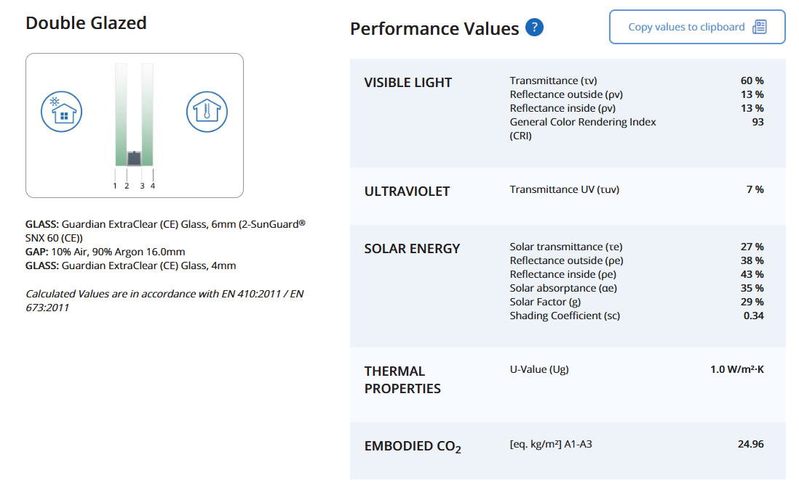
Precedents
SunGuard® eXtraSelective SNX 60
Precedents: built examples of the glass types discussed (manufacturer EN data – to be replaced by NFRC data for the agreed build-up).
Glass manufacturer: Guardian
LT: 60%
EN g-value (reference assembly): 0.29
Aviatica, Prague

Slide 14
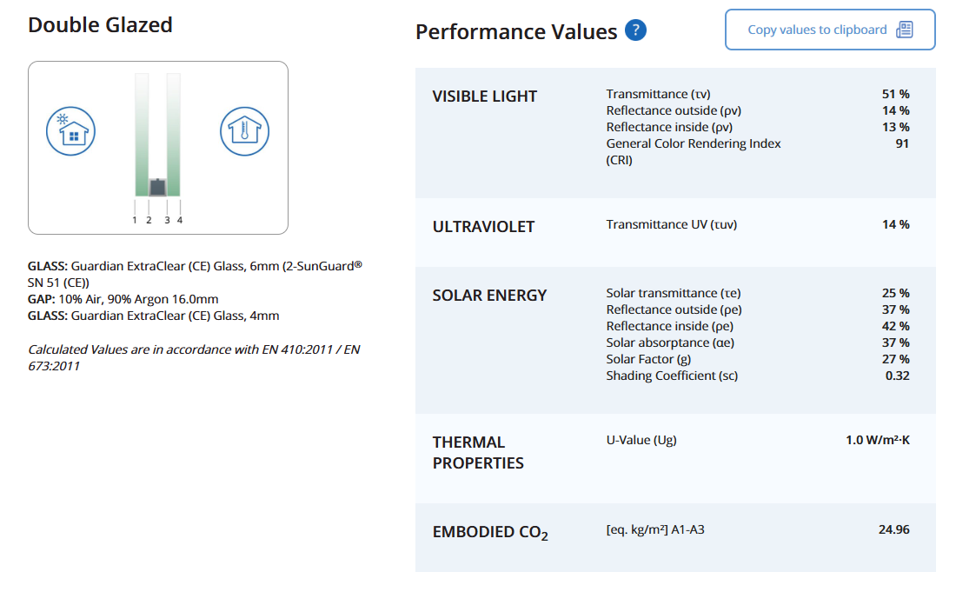
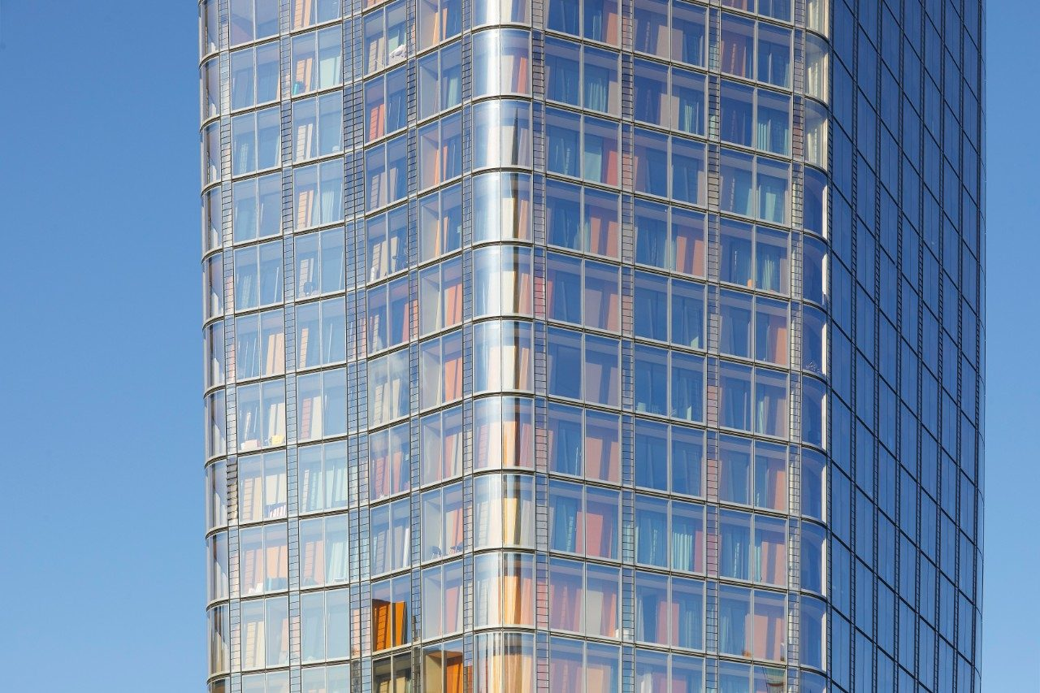
Precedents
SunGuard® SuperNeutral SN 51
Precedents: built examples of the glass types discussed (manufacturer EN data – to be replaced by NFRC data for the agreed build-up).
Glass manufacturer: Guardian
LT: 51%
EN g-value (reference assembly): 0.27
One Blackfriars, London

Slide 15
Thank you.
@eocengineers
Notes:
Choose one closing slide and delete the others as required.

